Slide 1
President-Elect Session
Sarah Leeson

Slide 2
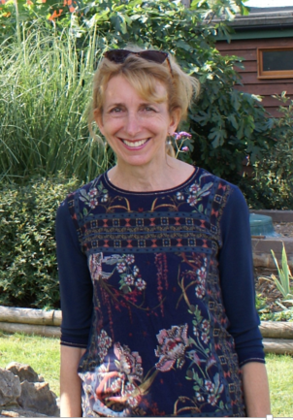
Quick Introduction
Chartered Occupational Hygienist, DipOH, CFFOH
President-Elect 2025-2026
Registrar for the Faculty of Occupational Hygiene between 2019-2025
  Previously a FOH committee member as well as having held other voluntary roles for BOHS
Regional Occupational Hygiene manager for ExxonMobil until taking early retirement in 2022
Other current activities include Co-Chair of another Charity board and volunteering at a Goat Sanctuary
LinkedIn

Slide 3
Improving the Recognition of our Senior Faculty members and retired Fellows
Chartered Fellow is an esteemed position for those who have reached the pinnacle of their professional society
Within this group there is wealth of expertise and knowledge
How can we both recognise these individuals and tap into their expertise and knowledge ?

Slide 4
Quick Quiz :
How many current Fellows are there ?
35
How many retired Fellows are there ?
17
How many ‘lost’ Fellows or retired Fellows are there ?
20
What is the average age of the current Fellows ?

Slide 5
Improving the Recognition of our senior Faculty members and retired Fellows
The Proposal :
Better engagement with existing Fellows and Retired Fellows as well as reaching out to those who have ‘’dropped off the radar’’
Create a pool of Fellows and Retired Fellows who could actively contribute to ongoing professional projects as well as Mentoring the next generation of professionals
In return :
Individuals would be eligible to be granted the title of ‘’Emeritus Fellow’’

Slide 6
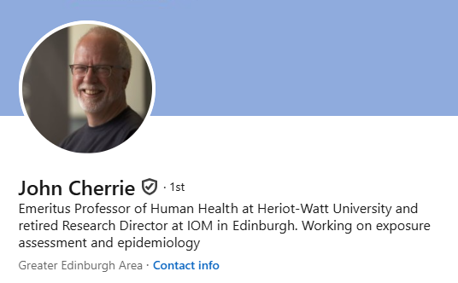
Improving the Recognition of our senior and retired Faculty members

Slide 7
Improving the Recognition of our senior Faculty members and retired Fellows
The Pool of Experts
Actively contribute to ongoing professional projects such as assistance to the Faculty SWGs, review of technical information, review of qualifications, assist the International Advisory Board for the Annals
Be Mentors the next generation of professionals
Quarterly updates to be provided on current BOHS activities
Networking opportunity – virtual and F2F at the annual conference

Slide 8
Improving the Recognition of our senior Faculty members and retired Fellows
Emeritus Fellow
The title of Emeritus Fellow would be awarded to Fellows at the point at which they choose to retire from active Occupational Hygiene practice, in recognition of their sustained and distinguished and ongoing contribution to the field of Occupational Hygiene and to BOHS.
The status is considered to be mutually beneficial and facilitates a continuing relationship, on a voluntary basis, between the retiree and the Faculty of Occupational Hygiene.

Slide 9
What about those entering the profession?
In addition, review the options to better engage with those entering the profession and tap into their ‘’younger’’ perspectives !

Slide 10
Plug for SWG4
Technical Guidance and Archived Technical Guidance
Members to be asked to identify any additional topic items for which guidance might be beneficial for Occupational Hygienists

