Slide 1
“The session will give a retrospective look of how occupational hygiene practice has changed and evolved over the last 20 to 30 years…”
The HSE phase contrast test slide
– an occupational hygiene practice that needs to change?
Trevor Ogden, OBE

Slide 2
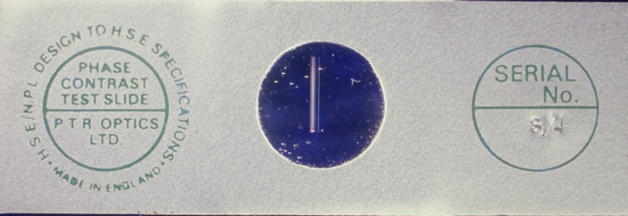
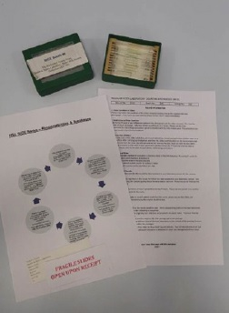
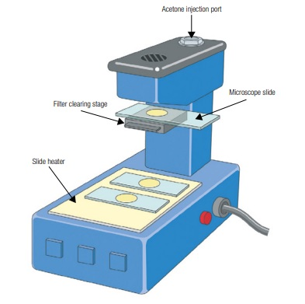
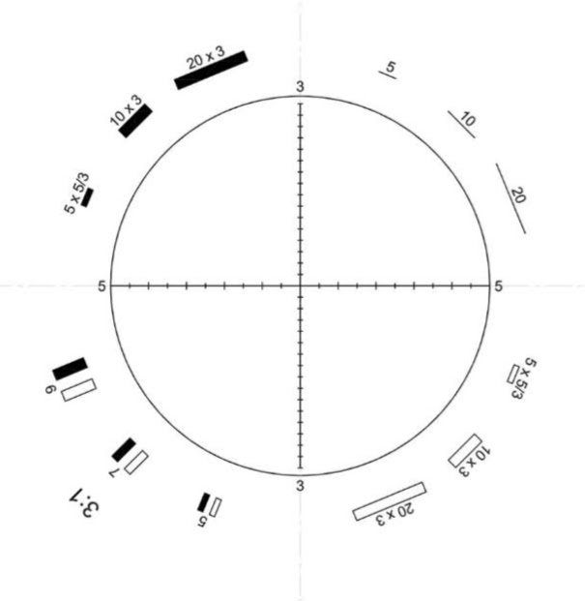
1977-86
A revolution in measuring asbestos concentrations
HSE Test Slide (1984)
Hot block (1986)*
Invented by Geoff Pickford
RICE Scheme (1984)*
Walton-Beckett Graticule (1977) © BOHS
*Crown Copyright

Slide 3
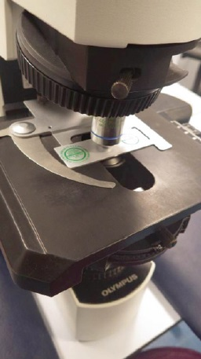
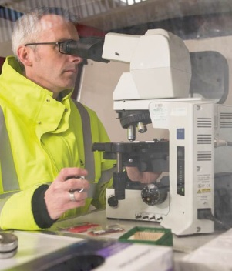
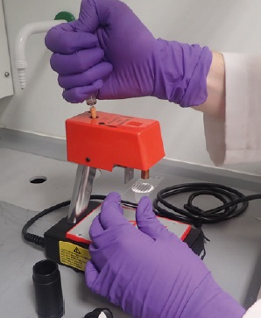
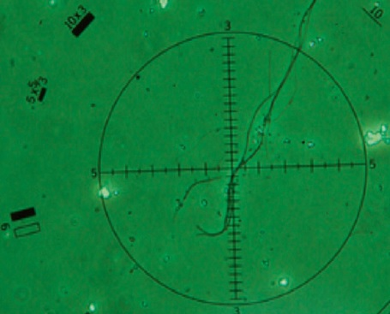
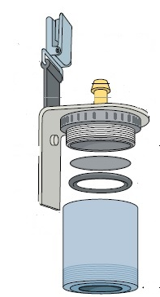
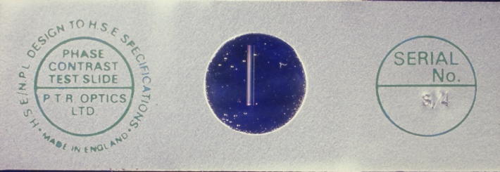
Measuring airborne asbestos concentration with HSG248
“Asbestos – the Analysts’ Guide”
© Crown Copyright

Slide 4
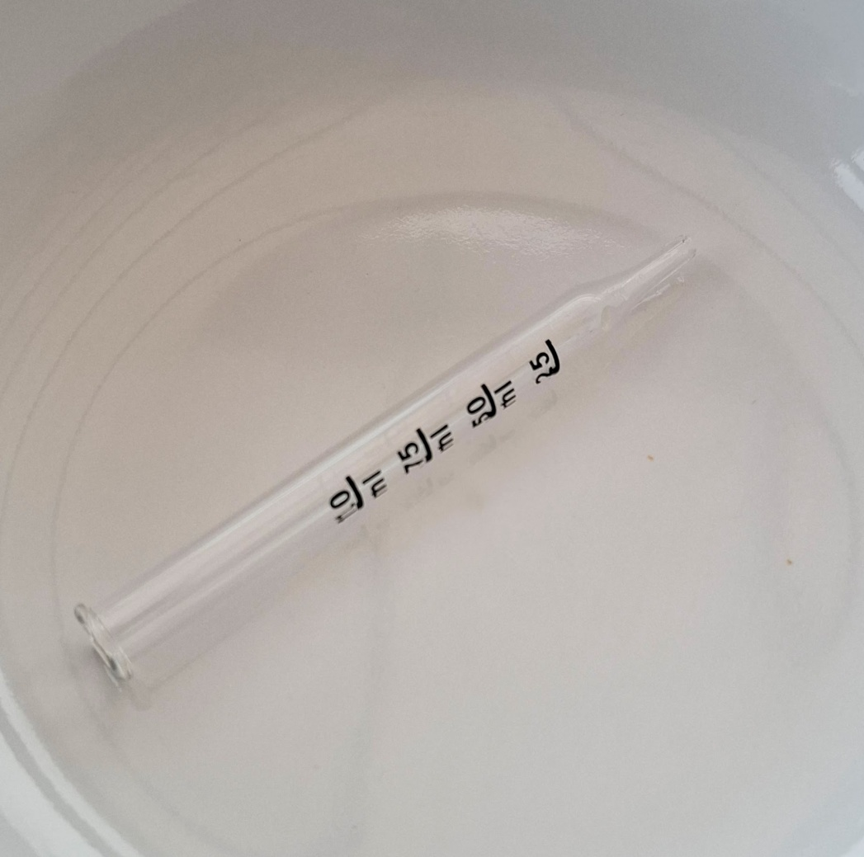
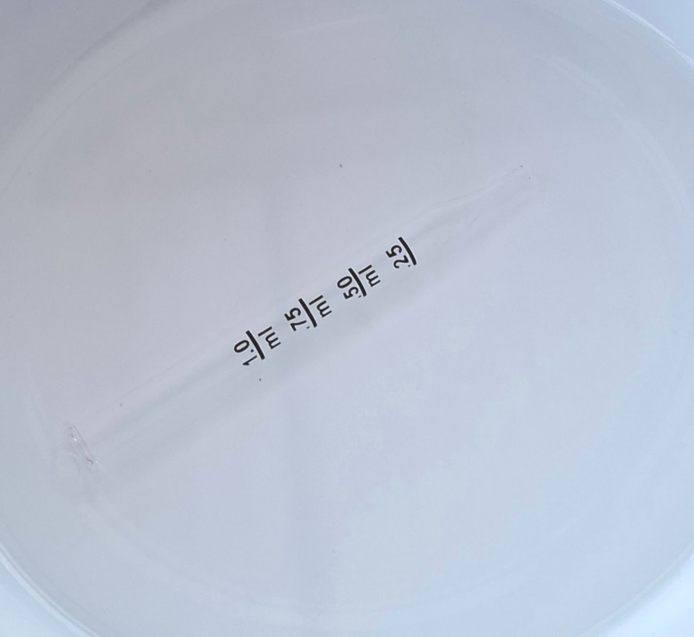
Looking at a transparent asbestos fibre on a cleared filter is like looking at a glass tube in a bowl of water
Glass tube in air
Refractive index of glass = 1.5
Refractive index of air = 1.0
Glass tube in water
Refractive index of glass = 1.5
Refractive index of water = 1.33
Refractive index of chrysotile = 1.54 Refractive index of cleared filter = 1.49
This is why we use phase contrast microscopy

Slide 5
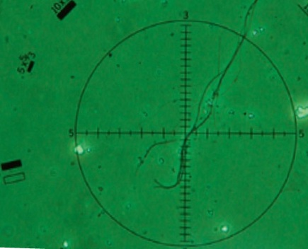
Asbestos fibres made visible by phase contrast microscopy, with a Walton-Beckett eyepiece graticule
From HSE, “Asbestos – the Analysts’ Guide”, HSG248 © Crown Copyright

Slide 6
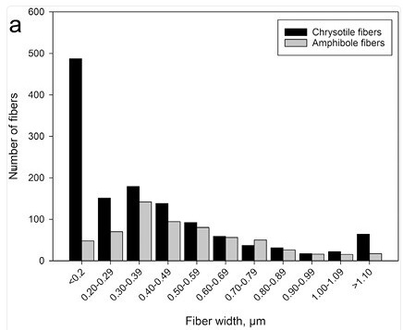
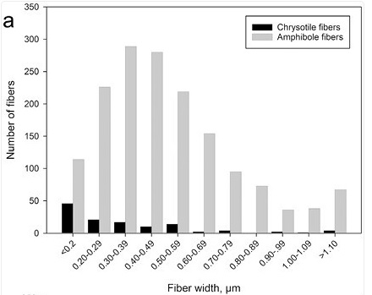
Asbestos diameter distributions of fibres longer than 5 μm, measured with an electron microscope. Most airborne fibres are very fine.
Removal of exterior asbestos cement
0.2
0.4
0.6
0.8
1.0
Fibre width (μm)
Removal of interior
wall boards
The number seen (and counted) will depend on the detection limit of the microscope – the size of the thinnest fibres that can be seen.
Distributions from : Ervik et al (2023) Measurements of airborne asbestos fibres during refurbishing. Ann Work Expo Hlth 67(8):952–964. © the authors. Reproduced under creative commons licence https://creativecommons.org/licenses/by-nc/4.0/)
0.2
0.4
0.6
0.8
1.0
Fibre width (μm)

Slide 7

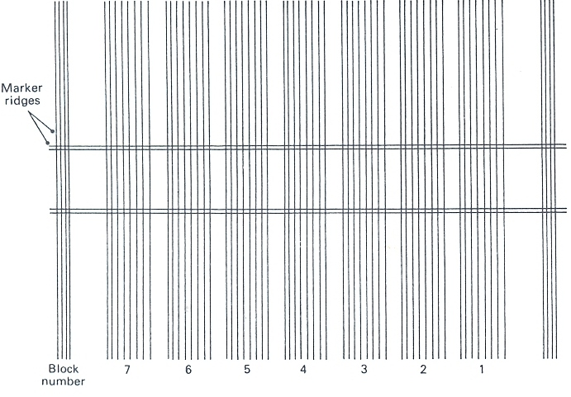
The HSE slide master
Cross-section of one of one of the grooves ruled in the aluminium
Arrangement of grooves in the aluminium master
Air
Aluminium deposited on the glass
Optically flat glass
Marker ridges
Finest block
Coarsest block

Slide 8

One of many parallel grooves ruled in the aluminium
The master is used to cast a grid of grooves of various widths in resin, which are then immersed in Euparal
Air
Glass cover slip
Air
Euparal
RI = 1.485
Aluminium deposited on the glass
RI = 1.58
Ridge cast in replicating resin
Optically flat glass
Glass slide
The height of each ridge is about one-tenth its width. The widths vary from about 1.08 μm in block 1 to about 0.25 μm in block 7.
The finest ridges are therefore 25 nanometres high.
Not to scale

Slide 9
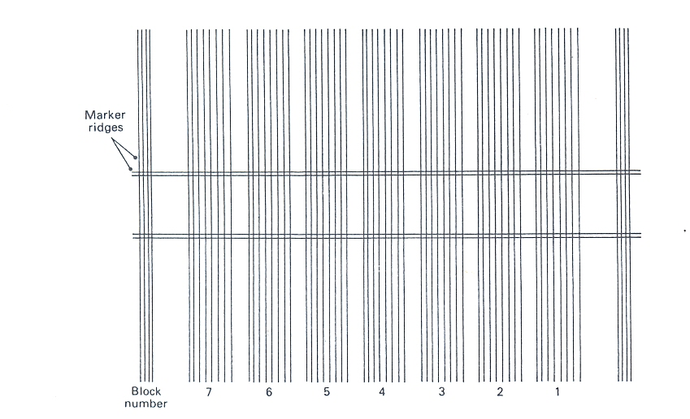
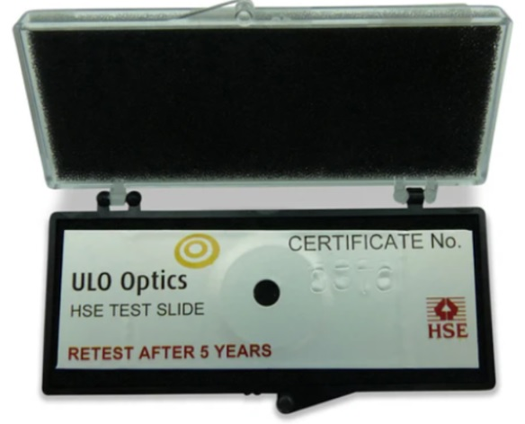
Block
1
1
2
3
4
5
6
7
The widths vary from about 1.08 μm in block 1 to about 0.25 μm in block 7.
The finest ridges are therefore about 25 nanometres high.

Slide 10
“The ridges of block 5 of an HSE Mark II test slide … must be visible, while only parts of block 6 ridges may be visible and none of block 7 ridges should be visible at the working magnification”
- HSE, HSG248, para A1.37

Slide 11
Each slide was inspected by someone in HSE laboratories to make sure that the visibility of the blocks was right. It was difficult to make slides in which the blocks were clear and had the right visibility. Sometimes 50% of those made were rejected. That was the mid-1980s. Production is now reported to be going OK.
Fast forward 33 years to 2017…

Slide 12
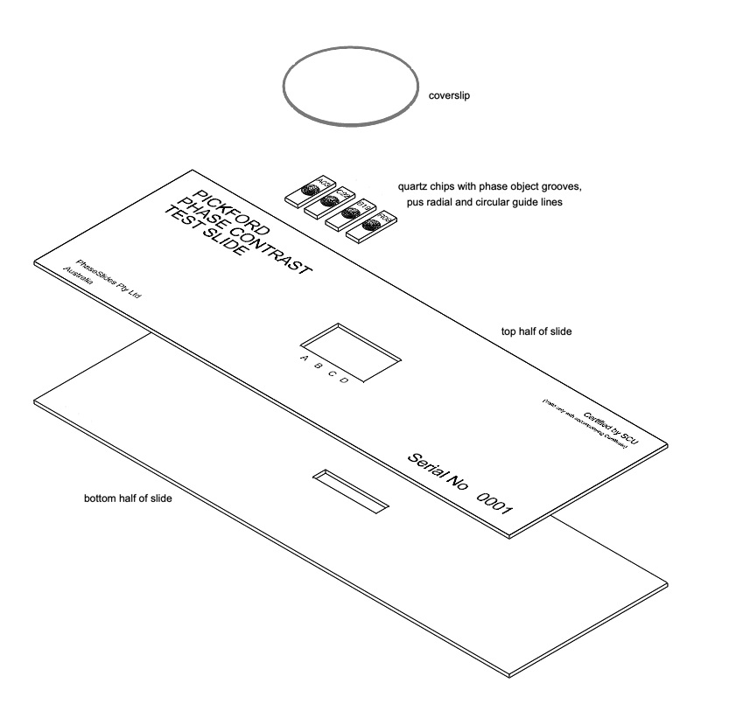
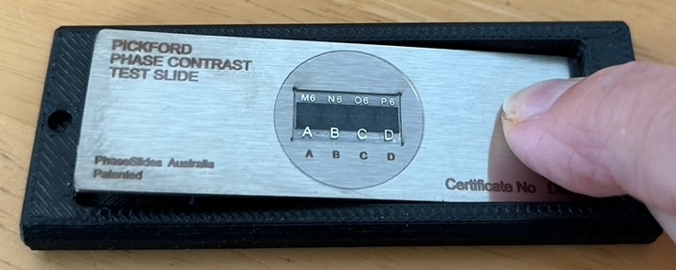
The Pickford Slide
Glass coverslip
4 fused quartz chips, A to D, with etched grooves , produced at the Australian National Fabrication Facility, University of New South Wales
The stainless steel top and bottom of the slide, which are put together with a permanent adhesive to make a microscope slide of conventional dimensions

Slide 13
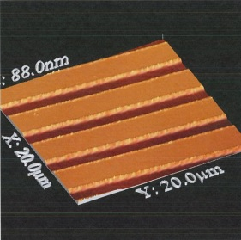
The phase objects of the Pickford slide
Each fused quartz chip has in the central square 20 parallel grooves 5 μm apart, produced by reactive ion etching
Each groove is 100 μm long and 1 μm wide.
The groove depths range from 90 nm (Chip A) to 5 nm (Chip D)
Surface of fused quartz chip
Groove (29 nm deep in this case)
Atomic Force Microscope photograph by the Australian National Fabrication Facility (University of New South Wales)
The grooves are filled with a UV-activated acrylic-based adhesive coating, which also fills the space between the chip and the cover slip
Refractive index of the quartz = 1.46, of the filling 1.48.

Slide 14
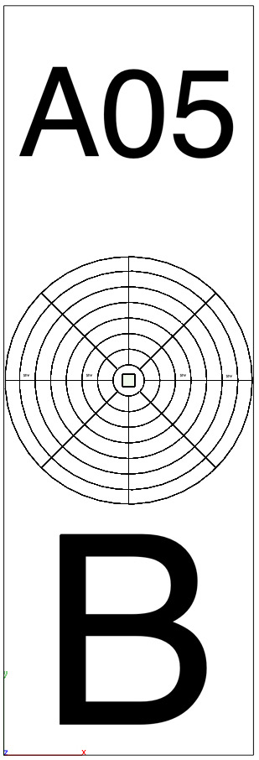
Enlargement of chip B
Glass coverslip
4 fused quartz chips, A to D, with etched grooves
The etched grooves are within the central square
Lines to guide the microscopist to the centre, where the grooves are
The stainless steel top and bottom of the slide, which are put together to make a microscope slide of conventional dimensions
To tell the microscopist which chip they are looking at!

Slide 15
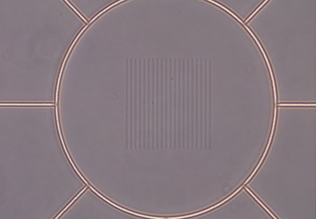
A Pickford slide test object

Slide 16
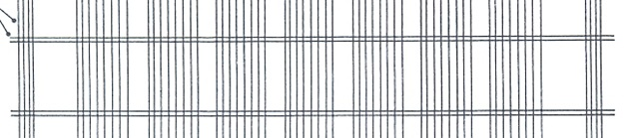
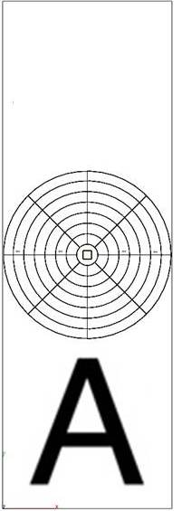
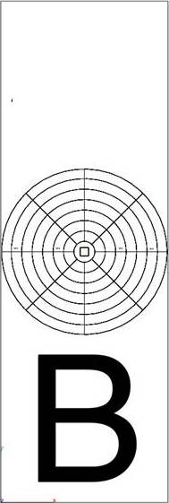
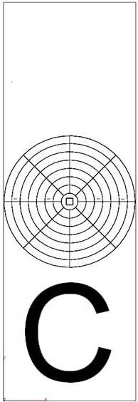
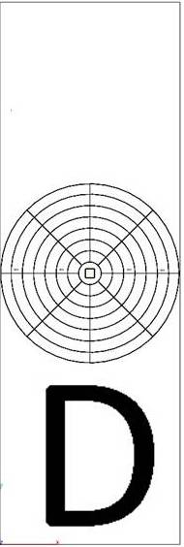
Performance comparison of the two slides
HSE slide block
1
2
3
4
5
6
7
Pickford slide chip
Each individual Pickford slide is certified as equivalent in performance to the HSE test slide by Southern Cross University Environmental Analysis Laboratory, operating under ISO/IEC 17025
Required microscope performance

Slide 17
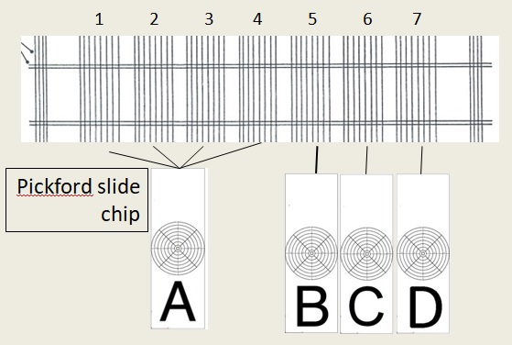
Visibility criterion with the Pickford slide
“Set B is equivalent to block 5 of the HSE/NPL Mark II, and all etched grooves should be faintly visible for satisfactory performance. Set C is equivalent to block 6… and some etched grooves may be partly visible or invisible for satisfactory performance . Set D is equivalent to block 7… and no etched grooves should be visible for satisfactory performance.”
- Pickford and Szymanska, Jl Occup Envir Hyg paper

Slide 18
Possible advantages of the Pickford Slide
Reliability. Reactive ion etching is an important process in electronic manufacture, and is probably more dependable than the mechanical moulding of resins. Semiconductor processing techniques would have been preferred if available in 1984.
No moulding and replication – each phase object is individually made.
Physical robustness. The HSE slide is glass; the Pickford slide is stainless steel, and will probably not be damaged if dropped
Ease of use. The guide lines and clear marking mean that the right area of the right chip can easily be located.
Stability. Each HSE test slide is supposed to be retested every five years – but is it done? No change has yet been observed in a Pickford slide
Clarity. The JOEH paper describes a lot of objective grey-level testing in relation to visibility, and this confirmed that the Pickford slides have a “much clearer background” than the HSE slides.

Slide 19
Can you use it? – the Regulations
The Control of Asbestos Regulations 2012
Reg. 2 (1) . “the control limit” means a concentration of asbestos in the atmosphere when measured in accordance with the 1997 WHO recommended method*, or by a method giving equivalent results to that method approved by the Executive…
Reg 2(4), …the concentration of asbestos in the atmosphere, when measured in accordance with the 1997 WHO recommended method* or by a method giving equivalent results to that method and approved by the Executive “approved” means approved for the time being in writing by the Executive.
*The only legally binding specification of the membrane filter method in Great Britain

Slide 20

Can you use it? – the Regulations
Section 3.2.2, Optical requirements
“The microscope should be set up so that the ridges in block 5 of an HSE/NPL Mark II test slide are visible; those in block 6 may be partially visible, but those in block 7 should not be visible.”
This statement is a performance standard which tells you what visibility the microscope must achieve. We now have a new way of testing that.

Slide 21
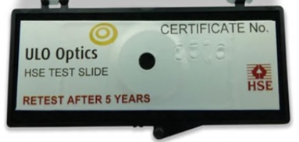
Can you use it? – the Guidance
“an HSE mark II (green certificate) test slide…or other HSE-approved test slide. ” [The Analysts’ Guide, HSG 248, para A1.22]
“Other HSE test slides may also be used, provided that it can be demonstrated that they give equivalent results to the HSE Mark II test slide. [Note: In other parts of the world other test slides are in use, which have blocks of ridges of differing visibilities at the working magnification from 3 to 7; and these cannot be used in the UK.] “ [HSG 248, para A1.37]

Slide 22
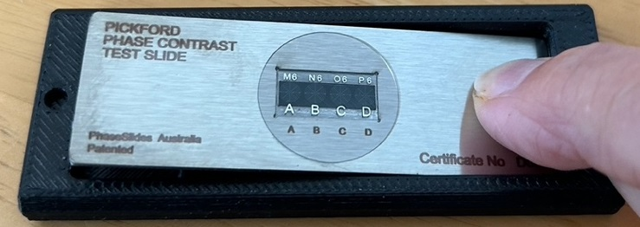
Can you use it? – the obstacle
Geoff Pickford tried to get approval for his slide, so it was an “HSE-approved slide”. The technical side had been agreed, but the draft contract required by HSE included:
“The Client shall not use the name of the Health and Safety Executive (including its Science Division, the Health and Safety Laboratory or any other associated part or division) in connection with any prospectus, advertisement, sales literature or any similar material.”
The Pickford slide could get approval, but he couldn’t tell potential customers that it was an HSE-approved slide, or show them the certificate.
Shhhhhhh….!

Slide 23
Deadlock
In Australia and New Zealand…
the Pickford slide is accepted as equivalent to the HSE slide on the basis of the comparison of each slide by a laboratory accredited to ISO/IEC 17025
In Great Britain…
You can legally use the slide, but you might have to argue with HSE and UKAS. If the slide is approved by HSE, potential customers can’t be told.
The NPL-manufactured master slide is 45 years old. Will it last forever?

Slide 24
Sources and Further Information
Le Guen JMM, Ogden TL, Shenton-Taylor T and Verrill JF. (1984) The HSE/NPL phase contrast test slide. Ann. Occup. Hyg. 28 (2): 237-247. (Free for BOHS members who’ve registered for the Annals)
Pickford G and Szymanska J. (2025) An alternative to the HSE/NPL Mark II phase contrast test slide for airborne asbestos fiber analysis laboratories J. Occup. Envir. Hyg. 22 (5): 425-436. (See Trevor Ogden if you can’t get this)
Determination of airborne fibre number concentrations. World Health Organization, Geneva, 1997. https://www.who.int/publications/i/item/9241544961 (Free to download)
The Control of Asbestos Regulations 2012, UK Statutory Instruments 2012 No.632. https://www.legislation.gov.uk/uksi/2012/632/part/1
Health and Safety Executive. Asbestos: The Analysts’ Guide .HSG248 (Second edition) Published 2021. https://www.hse.gov.uk/pubns/priced/hsg248.pdf
For further information About this talk: Trevor Ogden ogden@ogs.org.uk
About the Pickford slide: Geoff Pickford info@phaseslides.com.au www.phaseslides.com.au
Copyright The illustrations of the Pickford Slide are © Geoff Pickford, and are reproduced by permission.
Illustrations labelled “Crown Copyright” are from HSG248 (see above), and are public sector information licensed under the Open Government Licence v3.0. See https://www.nationalarchives.gov.uk/doc/open-government-licence/version/3/

Slide 25
