Slide 1

Occupational Hygiene in the Pharmaceutical Industry – From Then to Now. A Consultant’s Perspective
BOHS Regional Meeting, London
December 2025
Mike Perry CMFOH

Slide 2
Introduction
How the Pharma Industry has Changed in the last 30+ years – challenges for OH
Reflections of my role as an OH Consultant (soon to retire!)
My thanks to Martin Axon (Safebridge, retired) for sharing his thoughts too…
Notes:
Important to remember that pharma is a unique industry and changes in OH may not be reflected elsewhere.
This is a reflection of my own observations and experiences, so not attempting to extrapolate my views to the industry as a whole.
Timely as will be retiring soon.
Thank you to Martin Axon for sharing his thoughts too.

Slide 3
Mike Perry CMFOH Chartered Occupational Hygienist
Southbank University (1996)
Occupational and Environmental Hygiene BSc (hons) (4 Years)
Sypol Environmental Management Ltd (1996 -1999)
Environmental Health Concerns Ltd (1999 – 2006)
SafeBridge Europe, Ltd (2007 – 2016)
Pharmadagio Limited (2016 – present)
Notes:
Would’not normally include much detail here, but helpful for this talk to put my career into context with the discussion
Occupational hygiene degree as a ‘mature student’ – 35 years ago.
Many opportunities for sandwich placements, eg Boots in Nottingham.
Many students then – annual conference

Slide 4
Changes in the Pharma Industry
Growing industry, advancements in drug development
Significant long-term investment (research, facilities, equipment, people)
Increased awareness of drug toxicity, health and safety
Cleaner working environments
Control banding now widely used
Highly motivated staff, young professionals, supportive relaxed environments
Environment, Health and Safety
Multi-disciplinary teams- toxicologists, process engineers, containment engineers, occupational hygiene/general EHS
Fewer industry experts
Notes:
Huge investments.
Much building going on.
Good budgets for safety, integrated into facility and process design
Good and improving safety culture, record

Slide 5
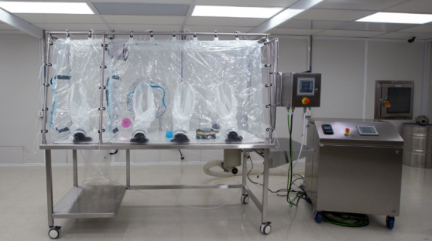
Driving Change in the Pharma Industry
Higher potency drugs
Smaller doses, fewer treatments, reduced side effects
Higher potency = lower and lower OELs
Increasing challenge for containment and control
Cancer drugs e.g. 0.2 ng/m³ – antibody-drug conjugate (ADC)
Advancements in containment technology
Novel transfer systems
More use of flexible containment
One-use isolators (picture courtesy of ILC Dover)
Notes:
An antibody–drug conjugate consists of three components:^{[34][35]}
Antibody - targets the cancer cell surface (antigen) and may also elicit a therapeutic response.
Payload - elicits the desired therapeutic response.
Linker - attaches the payload to the antibody and should be stable in circulation only releasing the payload at the desired target.

Slide 6
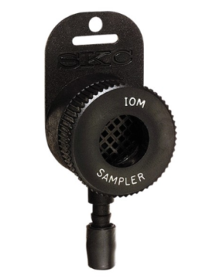
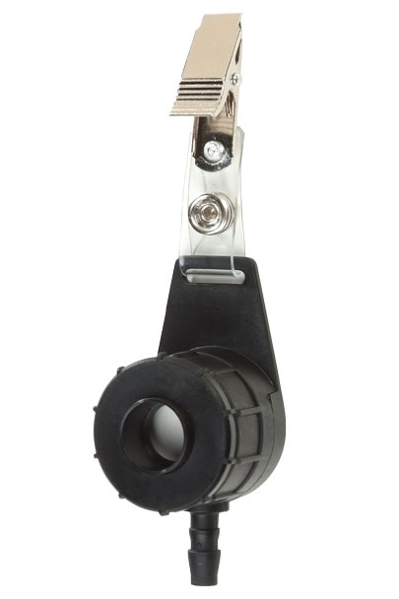
Quantitative Assessment
Containment performance data still required – we can’t see it!
Increasing reliance on use of surrogates for quantitative data
Analytical method development
Requirement for high sensitivity met with limited number of surrogates
Lactose, 0.050 ng/sample
Naproxen sodium, 0.005 ng/sample
OH tools
DIS sampler (IOM replica, one-use)

Slide 7
Have I Made a Difference?
Small number of loyal clients – Portugal, UK
All highly invested in improving
OH Consultant’s role has provided:
Focus, source of wide knowledge of the industry, technology, behaviours, standards achieved elsewhere
Good communication, caring
Personal touch
Advice highly valued
Example: we produce drug X, but want to produce more potent drug Y. Can we do it?

Slide 8
Wrap Up
In my experience, OH role has remained highly valued, effective, necessary
But…very few new faces, diminishing numbers - need for more specialist OHs
Mentors needed!
Thank you for listening ☺

