Slide 1
1
Spotting a Fake Respirator

Slide 2
Can You Spot a Fake Respirator?
2
Sadly, during the coronavirus pandemic the personal protective equipment (PPE) market is inundated with fake respirators claiming to be genuine.
These fakes will pose a health risk to anyone wearing them because they will provide little protection against the coronavirus.
These slides explain the markings expected to be found on genuine respirators and the information that should be contained in a EU Certificate and Declaration of Conformity (DoC).
The last slide contains useful links to other resources to help you identify whether a PPE product is genuine or not.

Slide 3
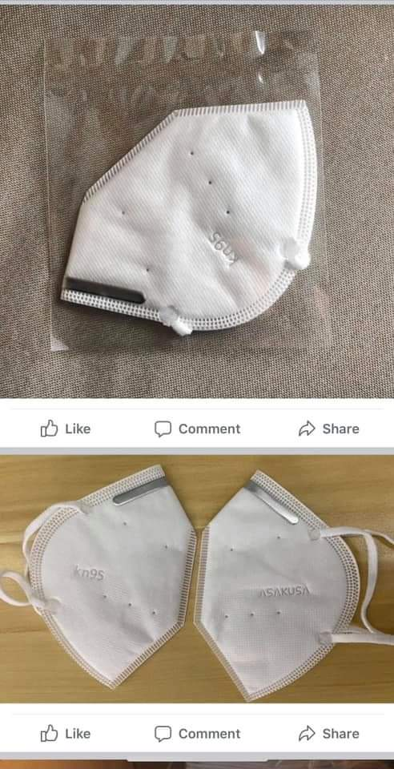
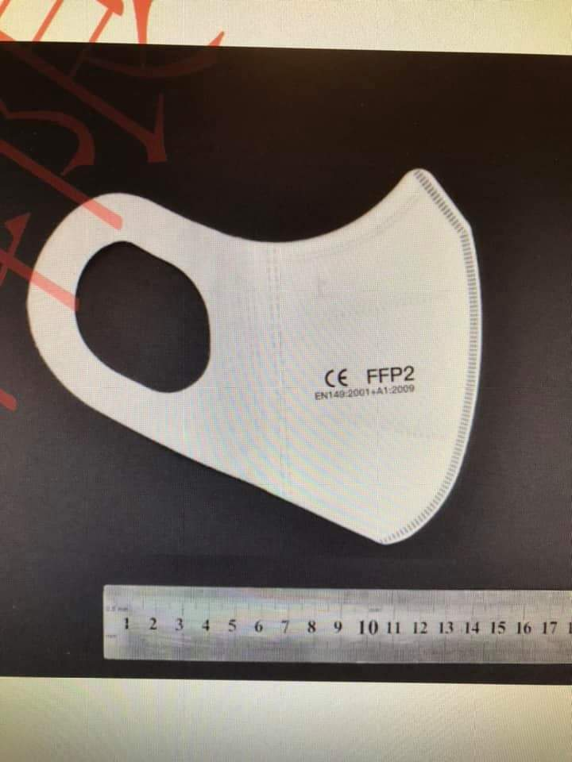
Genuine or Fake?
3

Slide 4

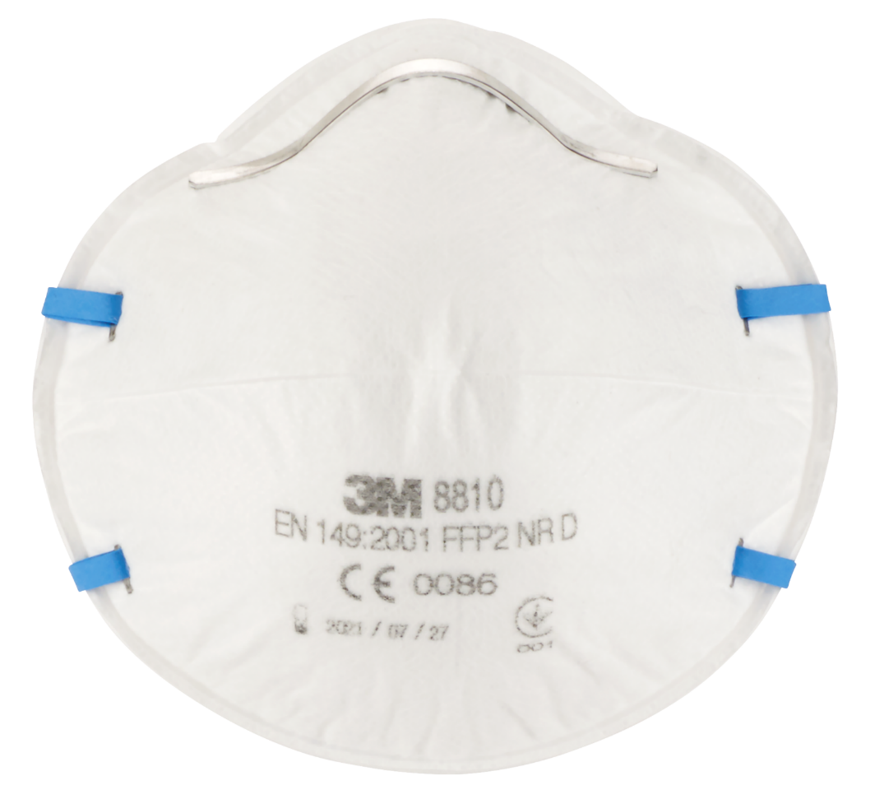
Spotting a Fake – Understanding FFP Markings
4
FFP
European Standard EN149 requires a FFP to have the following markings:
For example:
Manufacturer model number
8810
Manufacturer name or logo
3M
Filtering facepiece class
‘NR’ - Single shift use
‘R’ - Re-usable
3M
8810
European Standard number
EN149:2001
FFP2 NR
0086
EN149:2001
FFP2 NR
European certification mark
Notified Body responsible for the product certification
CE
0086

Slide 5

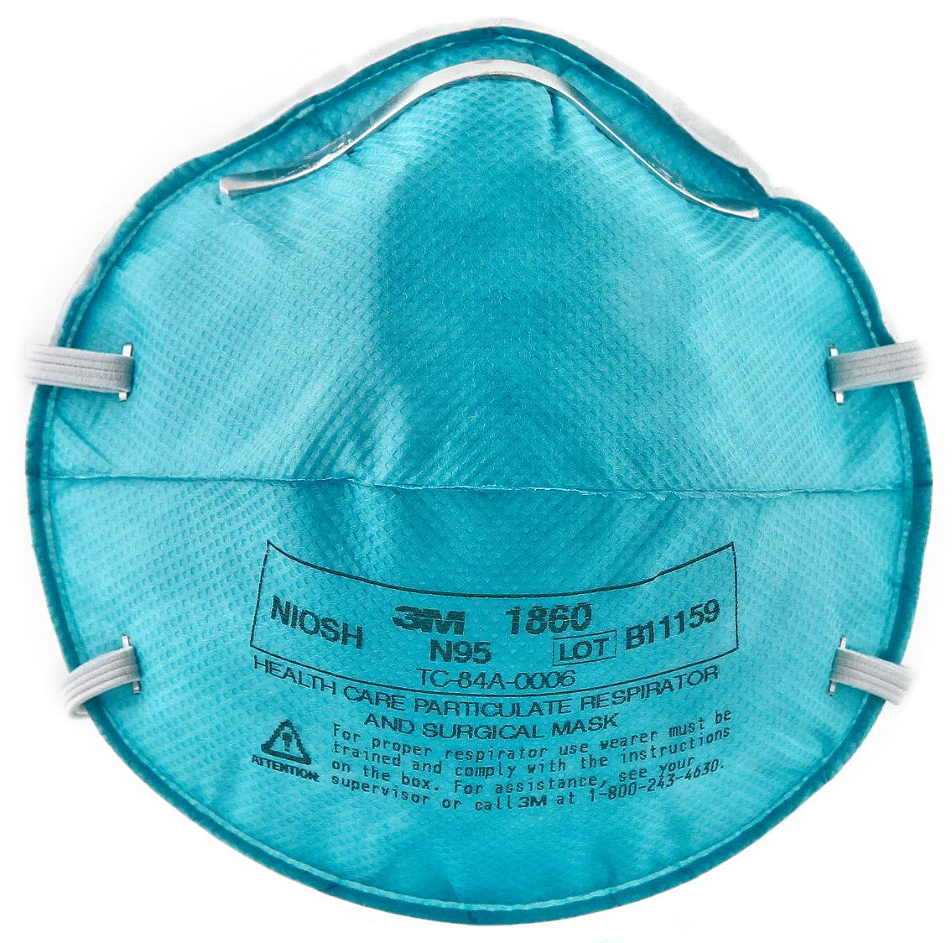
Spotting a Fake – Understanding FFP Markings
5
N95
NIOSH APR-FFR standard requires a FFP to have the following markings:
For example:
Manufacturer model number
Manufacturer name or logo
1860
3M
The word ‘NIOSH’
Manufacturer's lot number
NIOSH
B11159
NIOSH Approval number
Filtering facepiece class
TC-84A-0006
N95
IMPORTANT: N95 respirators can only be used by healthcare workers for protection against SARS-COV-2. Note: ‘Fast-tracked’ CE certified N95 may not carry a CE mark.

Slide 6
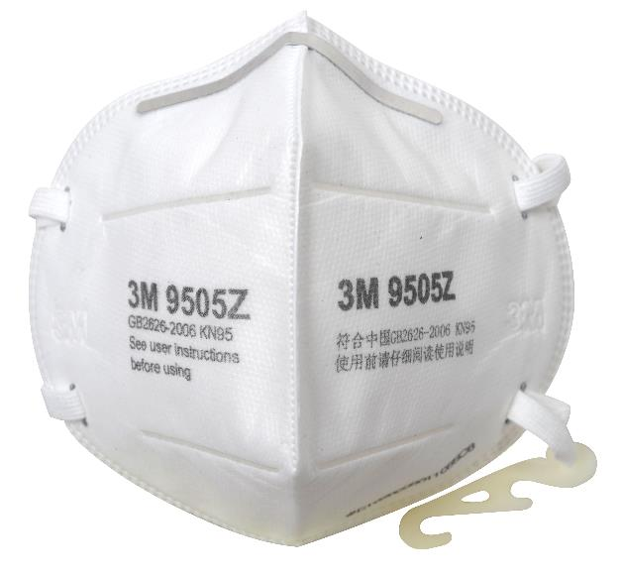
Spotting a Fake – Understanding FFP Markings
KN95
6
Chinese Standard GB2626-2006 requires a KN95 to have the following markings:
For example:
Manufacturer name or logo
3M
Manufacturer model number
9505Z
Filtering facepiece class
Chinese Standard
KN95
GB2626-2006
IMPORTANT: KN95 must not be used as PPE at work unless their supply has been agreed by HSE as the Market Surveillance Authority.

Slide 7
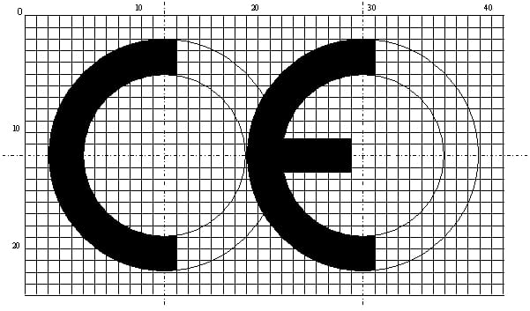
The Mark
7
The CE mark is a specific design and should appear as shown below:
Looks like a circle cut in half
Looks like a circle cut in half
The middle line of the ‘E’ does not extend to the centre of the circle

Slide 8

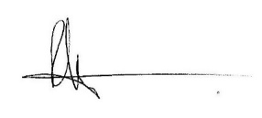
EU Type Examination Certificate
8
Example created to show content of a Module B EU Type Examination Certificate. This is a Mock Up – BSIF are NOT a Notified Body
Notified Body Name and number
AnySupply Ltd
1a High Street
Anyton
Anyshire
AN1 1NA
Certificate BSIF00125001
Certificate Number
Manufacturer name and address
It is certified that the manufacturers technical files and the PPE products detailed on this certificate have been assessed and found to be in accordance with
PPE Regulation (EU) 2016/425
Module B, EU type-examination
Approval to PPE Regulation
SAMPLE - NOT VALID
Date of Issue &
Date of Expiry
0101
Date of Issue:
01 April 2020
Date of Expiry:
31st March 2025
AS Safety Spectacle -300115
Subsequent pages with test details etc. listed
Product description and coding
It is certified that the manufacturer’s technical file and the above mentioned PPE have been assessed and found to meet the essential Health & Safety Requirements in Annex II of Regulation (EU) 2016/425 Personal Protective Equipment
Certification is based on technical file reference ASSS0012 and test results as detailed on following pages
Signature of authorised person at Notified Body
Authorised by
BSIF, Notified Body 0101
BSIF House
Hemel Hempstead, Herts.
HP1 3AF England
www.bsif.co.uk
Name, address, and number of Notified Body
Courtesy of BSIF
www.bsif.co.uk
www.fit2fit.org
This certificate remains the Property of BSIF to whom it must be returned on request

Slide 9

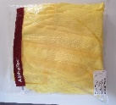

EU Declaration of Conformity (DoC)
9
Example created to show content of a Module B EU Type Examination Certificate. This is a Mock Up – BSIF are NOT a Notified Body
Company Logo
EU Declaration of Conformity No. 0105123
Title and Number of D of C
Name and Address of manufacturer
This declaration of Conformity is issued under the sole responsibility of the manufacturer:
BSIF
BSIF House
Hemel Hempstead
Herts. HP1 3AF
Description & code of PPE
Cov-R-All Chemical Protective Coverall C/w Hood
Code: CRA100 – Category III PPE
Yellow – Size Ranges Small to XXXL
Various Batch Numbers apply
Image of Product (Note: not all DoCs will contain an image)
SAMPLE - NOT VALID
Declaration of Compliance with PPE Regulation
The product referenced in this Declaration satisfies the essential Health & Safety requirements of Regulation (EU) 2016/425 Personal Protective Equipment
The product referenced in this declaration is issued in compliance with the following harmonised Standards
EN 13034:2005+A1:2009 Type 6 – Protection against reduced spray of liquid chemicals
EN ISO 13982-1:2004+A1:2010 Type 5 – Protection against hazardous particles
EN 14605:2005+A1:2009 Type 3 & 4 – Protection against liquid chemicals
EN 14126:2003 Type 3B/4B/5B/6B – Protection from biological hazards
EN 1149-5:2008 Electrostatic Properties – Performance requirements using EN1149-1:2006
EU Module B Type Certificate number: 5231105/1 Refers
Declaration of Compliance with specific standards
Details of Module B Certificate(s)
Details of Notified Body who issued Module B Certificate(s)
EU type Examinations by:
BTTG Testing & Certification Ltd
Unit 14, Wheel Forge Way
Trafford Park, Manchester, M17 1EH
Notified Body No: 0338
Module D QA Assessment by:
SATRA Technology Europe Ltd
Bracetown Business Park
Clonee, Dublin, D15 YN2P
Notified Body No: 2777
Details of Notified Body who conduct QA Module Assessment
Authorised and approved: 01/04/2020
Issued by:
EU DoC must be provided with the product or be available to download or on request to the PPE manufacturer/supplier.
Courtesy of BSIF
www.bsif.co.uk
www.fit2fit.org
Details of who (person) issued D of C and date of issue

Slide 10
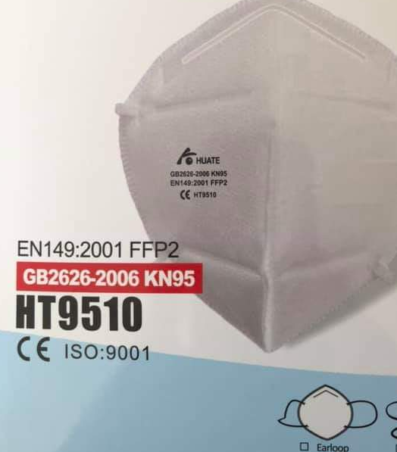
Genuine or Fake?
10
No Standard number
No manufacturer name, logo or model number
No markings on packaging
No EU CE mark and Notified Body number
Unusual design
No EU Notified Body Number
No manufacturer name, logo or model number
No ‘N’ or ‘NR’ marking
No EU Notified Body Number
No ‘N’ or ‘NR’ marking
ISO:9001 is not relevant to RPE certification

Slide 11
Spotting a Fake: 8-Point Summary
11
  Examine the markings on the product – are they all there and do they look correct?
  Is a copy of the EU certification and the Declaration of Conformity (DoC) available?
  Do the certificates and DoC contain the required information?
  Check the reference to the standard(s) on the product and on the certificates and DoC
  Are the manufacturers’ user instructions provided?
  Does the product look and feel right?
  Are there any misspelt words?
  If you are in doubt, check via the links in the resources provided on the next slide

Slide 12
Useful Resources
12
British Safety Industry Federation (BSIF): Fake PPE Certificates
https://www.bsif.co.uk/campaigns-projects/fake-certificate/
https://www.bsif.co.uk/are-you-concerned-about-ppe-certificates/
European Safety Federation: COVID-19 Suspicious certificates for PPE
https://www.eu-esf.org/covid-19/4513-covid-19-suspicious-certificates-for-ppe
HSE: Report a defective product
https://www.hse.gov.uk/work-equipment-machinery/report-defective-product.htm
EU Notified Bodies
https://ec.europa.eu/growth/tools-databases/nando/index.cfm?fuseaction=directive.notifiedbody&dir_id=155501

